Slide 1

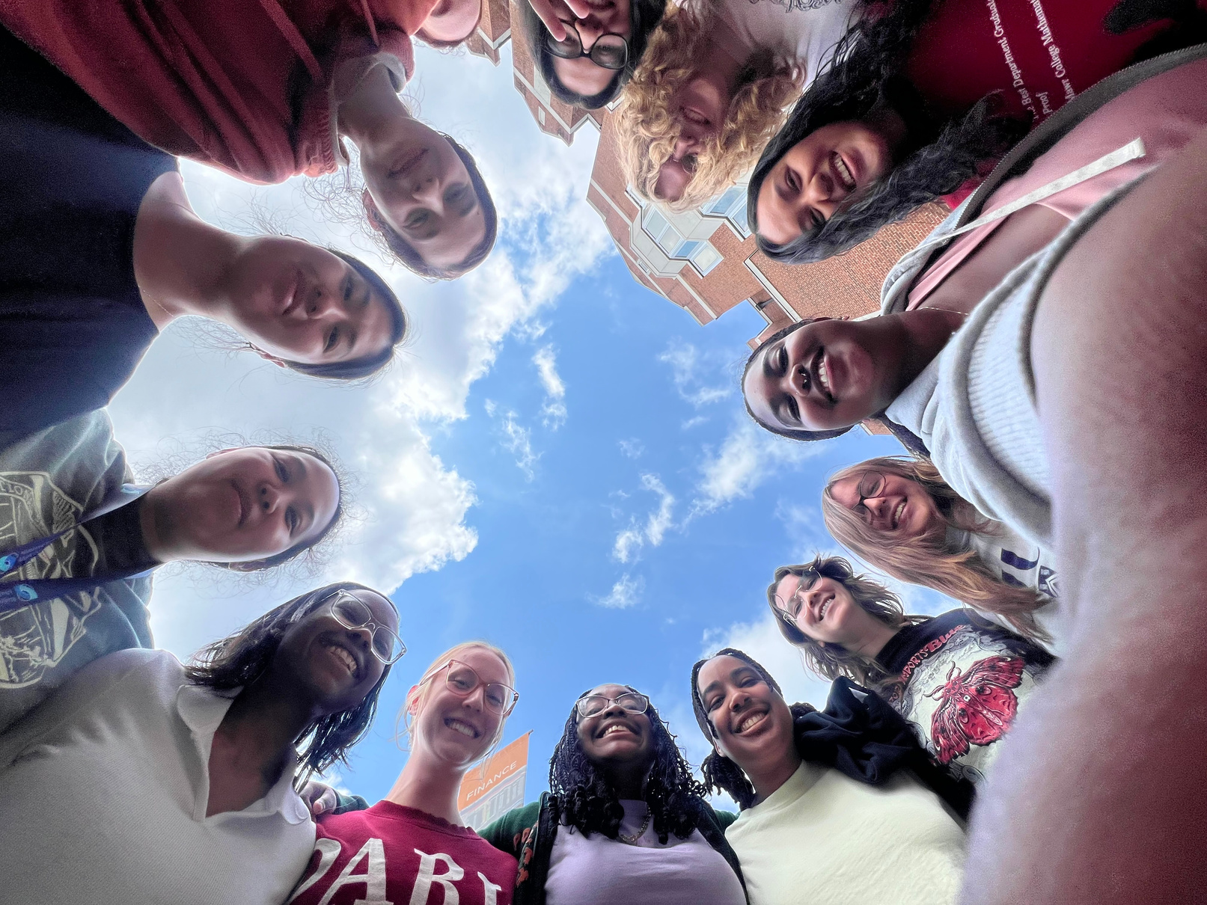
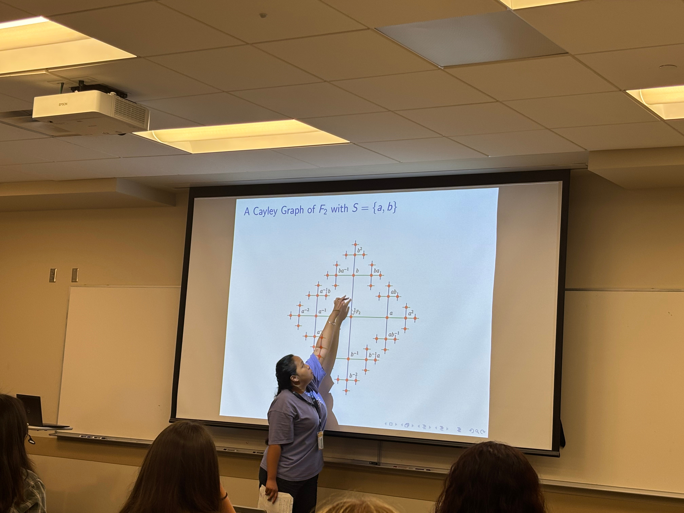
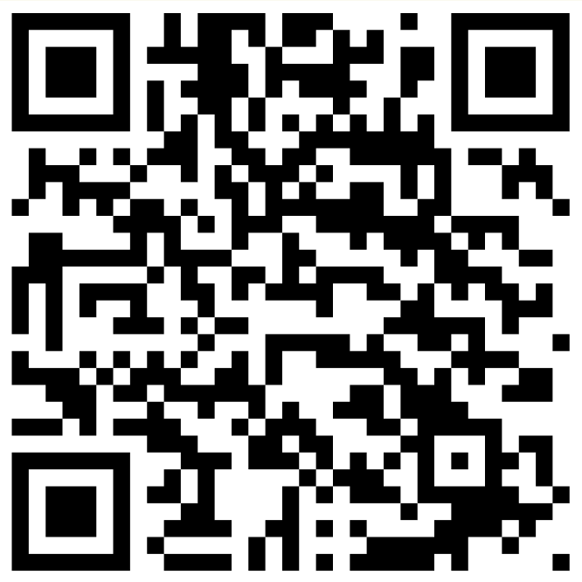
THE EDGE SUMMER PROGRAM
DEVELOP SKILLS FOR SUCCESS IN SCHOOL AND BEYOND
BUILD A PERSONAL AND PROFESSIONAL COMMUNITY
LEARN
CONNECT
THRIVE
APPLICATIONS AVAILABLE OCTOBER 2026
EDGE 2027

